Slide 1

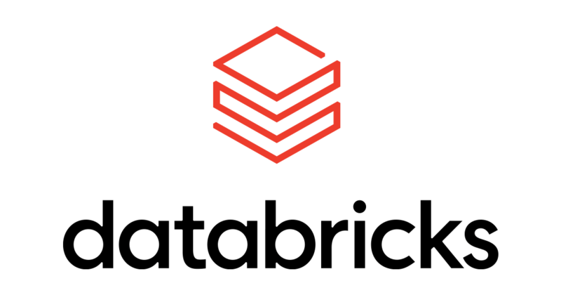
Welcome

Slide 2

Naval Yemul Databricks Instructor

Slide 3
BigData: PySpark
Naval Yemul

Slide 4
Big Data
Big data is data that contains greater variety, arriving in increasing volumes and with more velocity. This is also known as the 3’Vs.
Few Eg:
Amount of data generating per day
1. You Tube: Every hour 30 hours of videos are uploading.
2.In New York Stock Exchange
3.Social Media
4.Jet Engine
2.5 Quintillions(18 Zeros) Bytes of Data created every day.
Naval Yemul

Slide 5
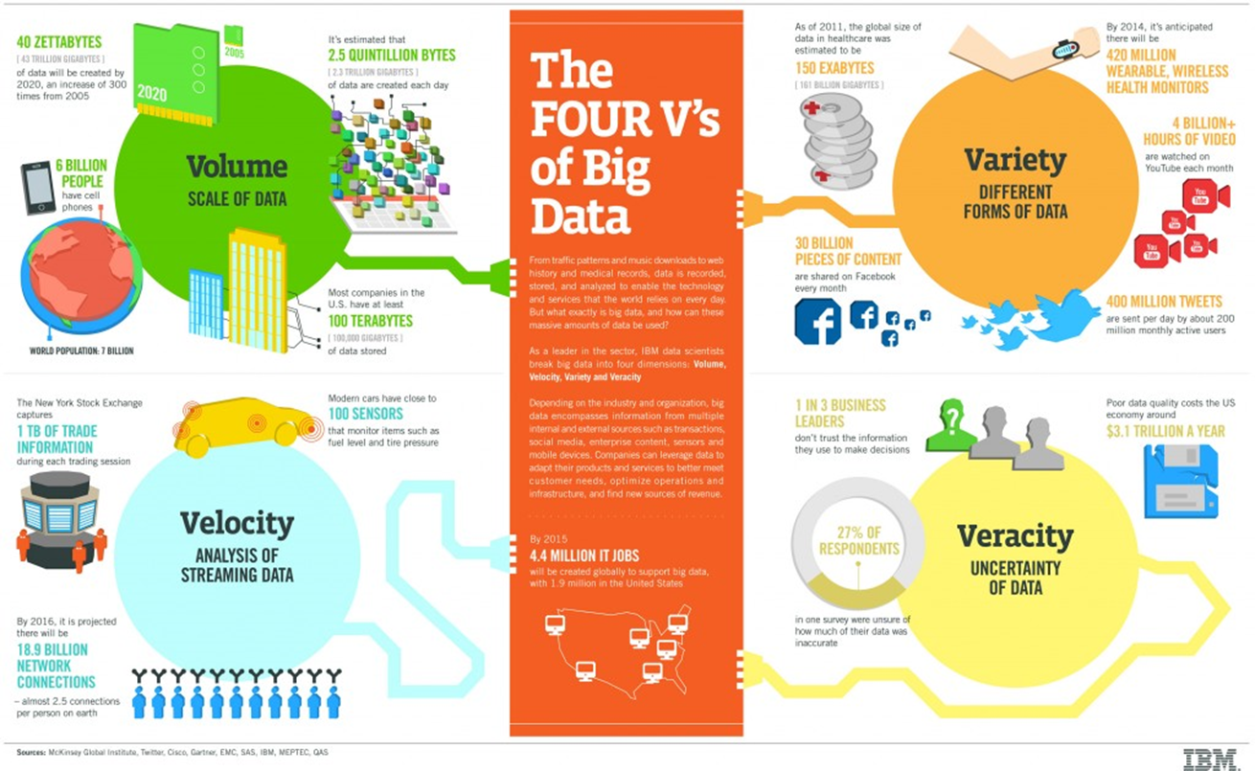
Naval Yemul

Slide 6
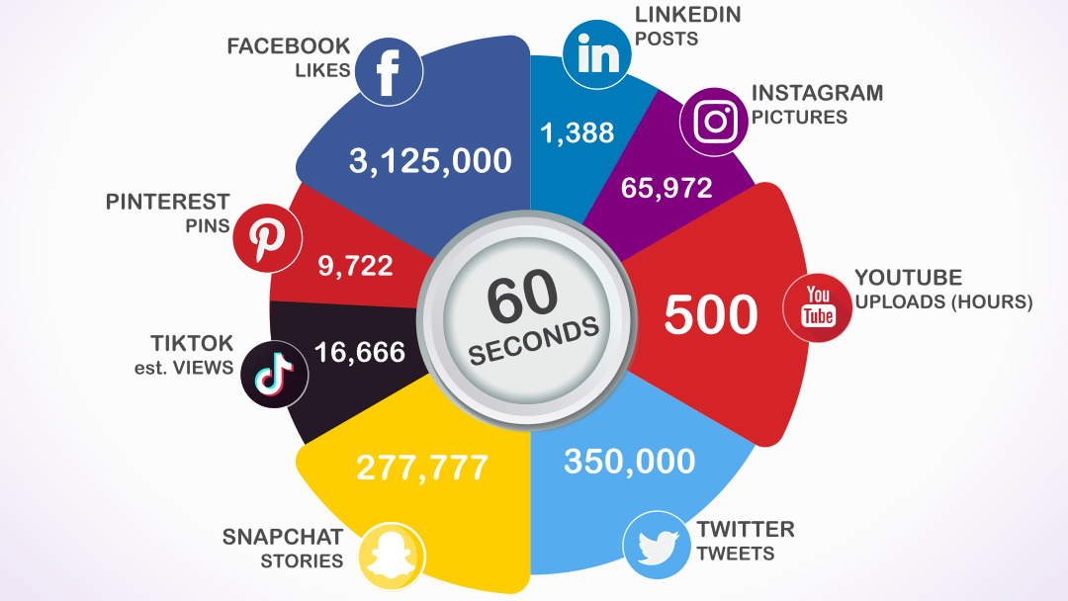
Naval Yemul

Slide 7
Forms of Big Data
•Structured
•Semi structured
•Unstructured data
 | Structured | Semi Structured | Unstructured data
Examples | 1.Excel Spreadsheet 2.CSV File 3.Relational Database | 1. (HTML) files 2. (JSON) files 3. (XML) files | 1.Images 2.Videos 3.Audio 4.Plain text files 5.Word files 6.PDF files
Naval Yemul

Slide 8
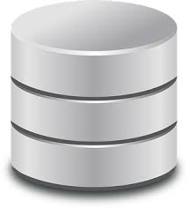
Why Big Data?
Store.
To process huge amount of data we first need to store it.
Are Traditional systems fit to store such huge amount of data?
Naval Yemul

Slide 9
Store
Store massive amount of data
Process
Process it in timely manner
Scale
Scale easily as data grows
Naval Yemul

Slide 10
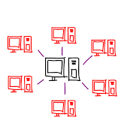
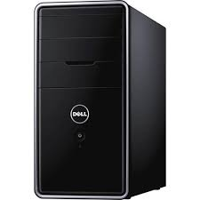
Monolithic System
Distributed System
Naval Yemul

Slide 11
Resources
RAM 16 Gb(Memory),
Hard Disk 1Tb(Storage),
CPU Quad Core (Compute)
Naval Yemul

Slide 12

Hadoop
Hadoop is a framework to solve Bigdata problems ​
Apache Hadoop is one of the most popularly used tools in the Big Data industry.​
Hadoop is an open-source framework from Apache and runs on commodity hardware. It is used to store process and analyze Big Data.
Naval Yemul

Slide 13
Hadoop Evolution
2003:
Google released a paper to describe how to store large datasets
On distributed Storage
This paper was called as GFS(Google File System)
2004:
Google released another paper to describe how to process large datasets
On processing
This paper was called MapReduce.
2006:
Yahoo took these papers and implemented it.
The implementation of GFS was named as HDFS(Hadoop Distributed File System)
The implementation of MapReduce was named as MapReduce.
Naval Yemul

Slide 14
Hadoop 1.0
MapReduce
HDFS
Naval Yemul

Slide 15
2009. Hadoop came under Apache Software Foundation and become open source
2013
Hadoop released 2.0
The Apache Software Foundation is an American nonprofit corporation to support a number of open source software projects.
THE WORLD'S LARGEST OPEN SOURCE FOUNDATION
Naval Yemul

Slide 16
Hadoop 1.0
Hadoop 2.0
MapReduce
MapReduce
YARN
HDFS
HDFS
Naval Yemul

Slide 17
YARN
Yet Another Resource Negotiator
Mainly responsible for Resource Management
Naval Yemul

Slide 18
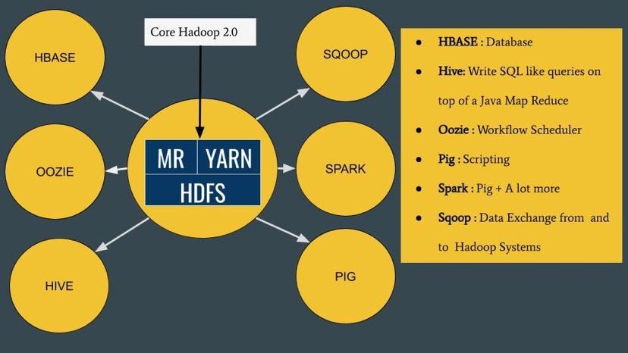
Naval Yemul

Slide 19



Big Data Tools
Figure: Various Big data tools
Naval Yemul

Slide 20
Hadoop
Apache Hadoop is one of the most popularly used tools in the Big Data industry.
Hadoop is an open-source framework from Apache and runs on commodity hardware. It is used to store process and analyze Big Data.
Naval Yemul

Slide 21
Apache Spark
Spark can be considered as the successor of Hadoop as it overcomes the drawbacks of it. Spark, unlike Hadoop, supports both real-time as well as batch processing. It is a general-purpose clustering system.
It also supports in-memory calculations, which makes it 100 times faster than Hadoop. This is made possible by reducing the number of read/write operations into the disk.
It offers high-level APIs in Java, Python, Scala and R.
Spark also offers a substantial set of high-level tools including
Spark SQL, MLlib, GraphX, and Spark Streaming.
Naval Yemul

Slide 22
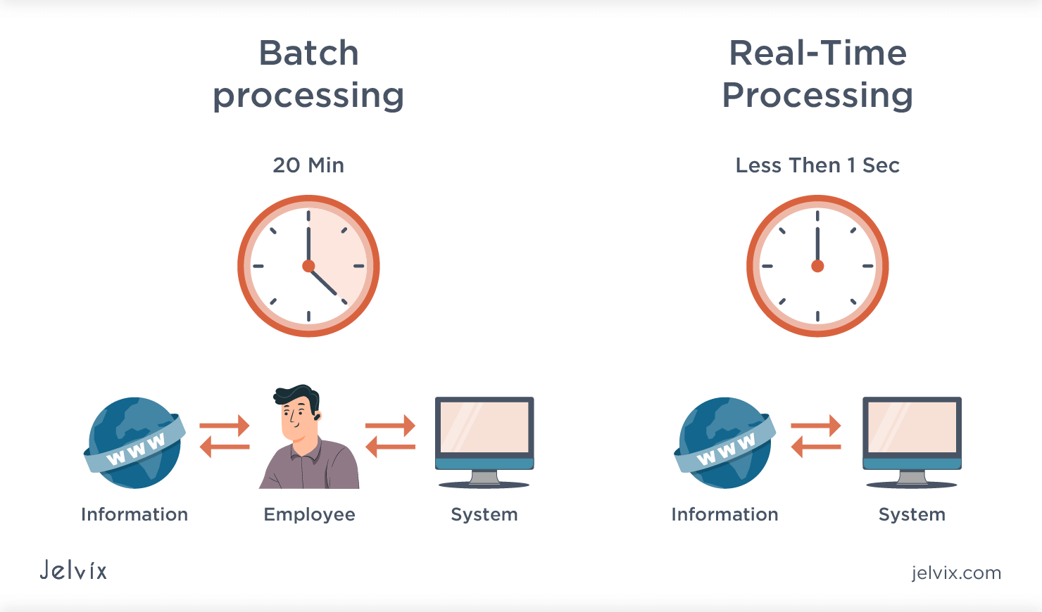
Apache Spark
Unifies
Batch processing
Real Time processing
Stream Analytics
Machine Learning
Interactive SQL
Figure: Batch processing vs Real Time processing
Naval Yemul

Slide 24

Hadoop vs Spark
Hadoop | Spark
Yahoo Project in 2006 | AMP Lab at UC Berkeley in 2012
Faster than traditional system | 100 times faster than Hadoop
Lengthy and complex framework | Simple and user friendly system
Hadoop is designed to handle batch processing efficiently | Spark is designed to handle both batch and real-time data efficiently
Table: Hadoop vs Spark
Naval Yemul

Slide 25
Hadoop vs Spark
Hadoop | Spark
Hadoop is an open source framework which uses a MapReduce algorithm | Spark is lighting fast cluster computing technology, which extends the MapReduce model to efficiently use with more types of computations
Hadoop MapReduce model reads and writes from a disk, thus slow down the processing speed | Spark reduces the number of read/write cycles to disk and store intermediate data-in memory, hence faster processing speed
Low Cost | High Cost
Table: Hadoop vs Spark
Naval Yemul

Slide 26

History of Spark
Apache Spark started in 2009 as a research project at UC Berkley’s AMP Lab, a collaboration involving students, researchers, and faculty, focused on data-intensive application domains.
Today, Spark has become one of the most active projects in the Hadoop ecosystem, with many organizations adopting Spark alongside Hadoop to process big data.
Naval Yemul

Slide 27
Features
1. Lightning-fast processing speed
2. Ease of use
3. Real-time stream processing
4. Active and expanding community
Naval Yemul

Slide 28

PySpark
Naval Yemul

Slide 29

Spark's Basic Architecture
Figure: Spark Architecture
Naval Yemul

Slide 30
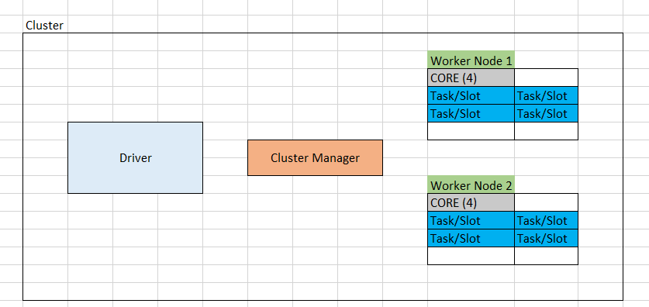
Spark's Architecture
Figure: Spark Architecture
Naval Yemul

Slide 31
Cluster Manager
Standalone – a simple cluster manager included with Spark that makes it easy to set up a cluster.
Apache Mesos – a general cluster manager that can also run Hadoop MapReduce and service applications.
Hadoop YARN – the resource manager in Hadoop 2.
Kubernetes – an open-source system for automating deployment, scaling, and management of containerized applications.
Naval Yemul

Slide 32

Application A1
Executor
Driver
spark-submit
Executor
Client Machine
Cluster
Naval Yemul

Slide 33
Application A1
Executor
Driver
spark-submit
Executor
Application A2
Executor
Driver
spark-submit
Client Machine
Executor
Cluster
Naval Yemul

Slide 34
Executor
Driver
Analysing
Distributing
Scheduling
Monitoring
Executor
Executor
Driver
Client Machine
Executor
Cluster
Naval Yemul

Slide 35
Who Executes where?
Client Mode
Cluster Mode
Executor
Executor
Client Machine
Cluster

Slide 36
Who Executes where?
Client Mode
Cluster Mode
Executor
Executor
Client Machine
Cluster

Slide 37
Who Executes where?
1. Client Mode
Executor
Driver
Executor
Client Machine
Cluster

Slide 38
Who Executes where?
2. Cluster Mode
Executor
Driver
Executor
Client Machine
Cluster

Slide 39
Spark JVM
Driver
Executor
Local Machine

Slide 40
Summary
Spark creates one drive and bunch of executors for each application
Spark offers two deployment mode for an application
Client Mode: Driver on client machine and executor on cluster
Cluster Mode: Driver and executor on cluster

Slide 41
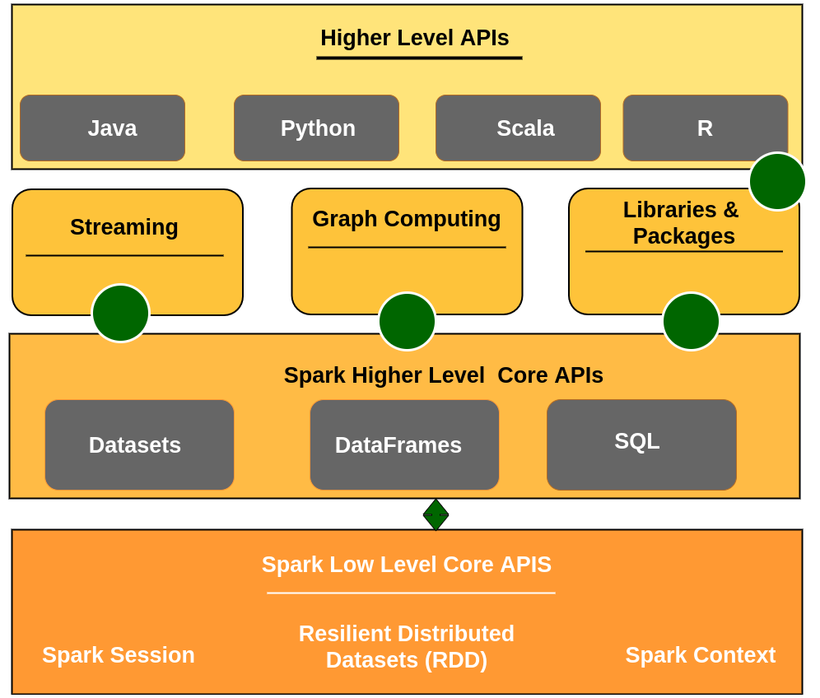
Spark’s Toolset
Figure: Spark Toolset

Slide 42
Spark Components
DataFrame | Spark SQL | Spark Streaming | Mlib (Machine Learning) | GraphX (Graph)
Spark Core
Figure: Spark Components

Slide 43
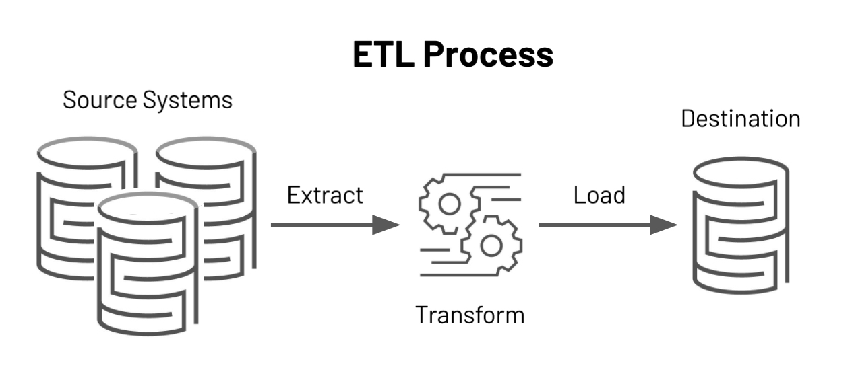
RDD, Dataframe and Dataset
RDD
DataFrame
Dataset

Slide 44
2013
2015
DataFrame
Dataset
RDD
2011

Slide 45
RDD
Resilient Distributed Dataset (RDD)
Spark RDD is resilient, partitioned, distributed and immutable collection of data.
Collection of data: RDD holds data and appears to be a Scala collection
Resilient: RDD’s are fault tolerant.
Partition: Spark breaks the RDD into smaller chunks of data. These pieces are called partitions.
Distributed: Spark distributes these partitions across the cluster.
Immutable: Once defined you can’t change them.

Slide 46
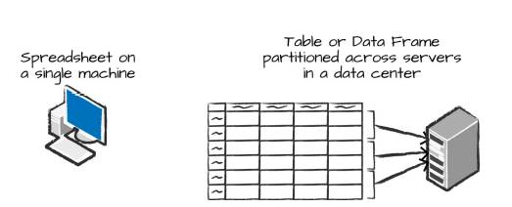
DataFrame
A DataFrame is the most common Structured API and simply represents a table of data with rows and columns.
Similar to database table
The list that defines the columns and the types within those columns is called the schema.
Figure : Distributed versus single machine analysis.

Slide 47
 | RDD | Data Frame | Dataset
version | 1.0 | 1.3 | 1.6
Data Representation | Distributed collection of elements | Distributed collection of data organized into column | Combination of RDD & DF
Data formats | Structured and unstructured | Structured and semi Structured | Structured and unstructured
Optimization | No built in optimization engine. | Query optimization through the catalyst optimizer | Query optimization through the catalyst optimizer, like DF
Programming Language | Java Scala Python R | Java Scala Python R | Java Scala
Aggregations | Hard, slow to perform | Fast for exploratory analysis. Quick | Fast for exploratory analysis. Quick
 |  |  | Combine the performance optimization of DF and convenience of RDD
 |  | Untyped: Python and R | (Strongly Typed API)- Java and Scala

Slide 48
Spark Context
SparkContext is the entry point of Spark functionality.
It is used to communicate with cluster and to create RDD
The most important step of any Spark driver application is to generate SparkContext.
It allows your Spark Application to access Spark Cluster with the help of Resource Manager.
The resource manager can be one of these three- Spark Standalone, YARN, Apache Mesos.

Slide 49
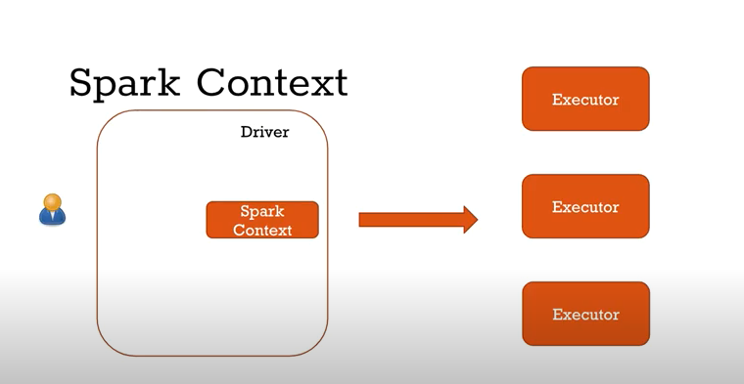
Spark Context
Note: You can create only one SparkContext per JVM, in order to create another first you need to stop the existing one using stop() method

Slide 50
Creating Spark Context
import pyspark
from pyspark import SparkContext
conf=pyspark.SparkConf().setMaster("local").setAppName("My first Spark")
sc=SparkContext(conf=conf)
sc.getConf().getAll()

Slide 51
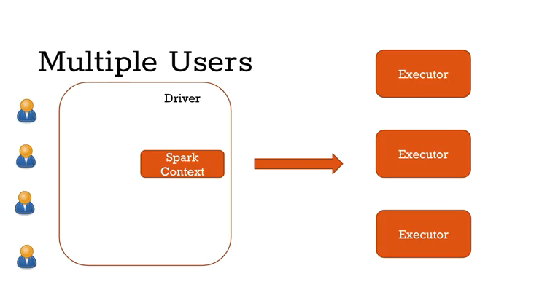

Slide 52
Spark Session
Since Spark 2.0
Spark application is controlled by driver process called Spark Session.
Spark Session is an entry point to underlying Spark functionality in order to programmatically create Spark RDD, DataFrame, and Dataset.

Slide 53
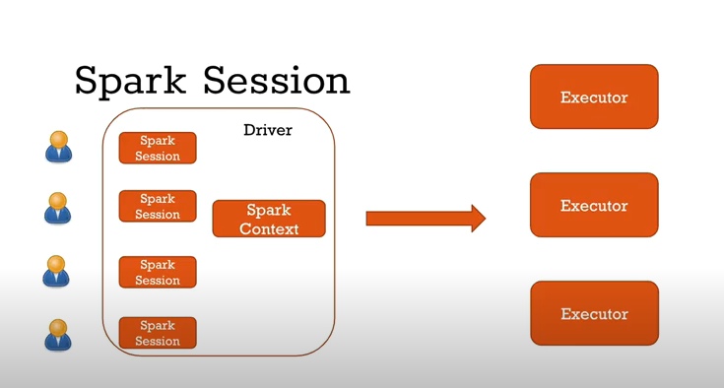

Slide 54
Creating Spark Session
# Create SparkSession from builder
import pyspark
from pyspark.sql import SparkSession
spark = SparkSession.builder.master("local[1]") \
.appName('SparkByExamples.com') \
.getOrCreate()
It’s object spark is default available in spark-shell and it can be created programmatically using SparkSession builder pattern.

Slide 55
Transformation
Transformations instruct the Spark cluster to perform changes to the DataFrame.
These are further categorized into narrow transformations and wide transformations.
Wide transformations lead to the shuffling of data as data requires movement across executors, whereas narrow transformations do not lead to re-partitioning across executors.

Slide 56
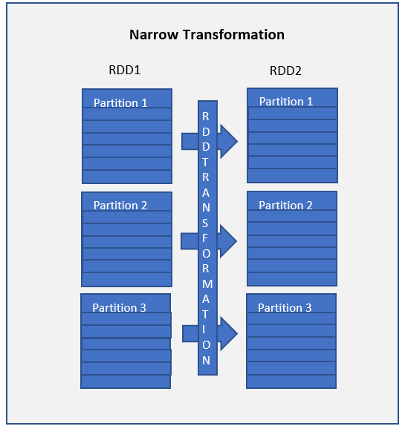
Narrow transformations are the result of map() and filter() functions
Functions such as map(), mapPartition(), flatMap(), filter(), union() are some examples of narrow transformation

Slide 57
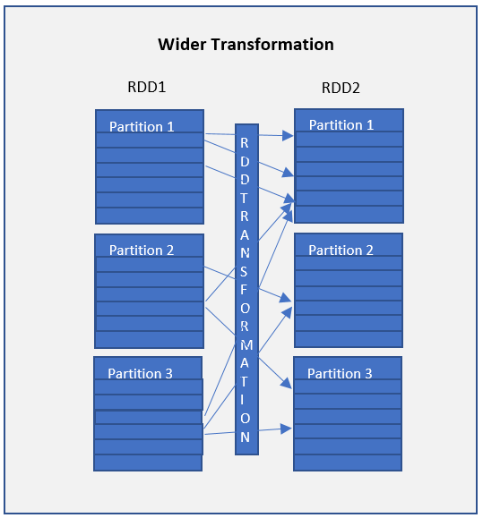
Wider transformations are the result of groupByKey() and reduceByKey() functions
Functions such as groupByKey(), aggregateByKey(), aggregate(), join(), repartition() are some examples of a wider transformations.

Slide 58
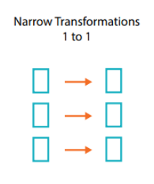
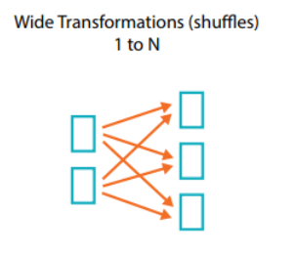

Slide 59
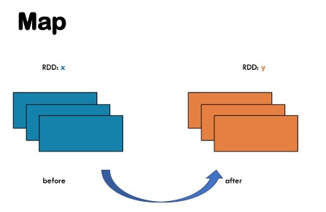

Slide 60
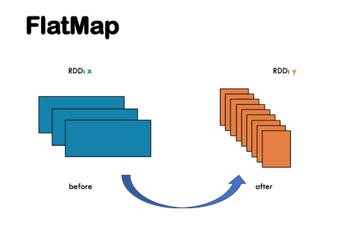

Slide 61
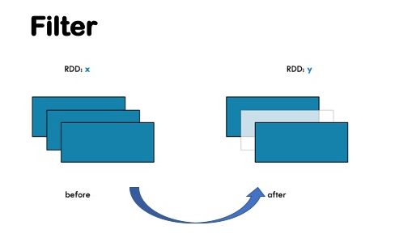

Slide 62
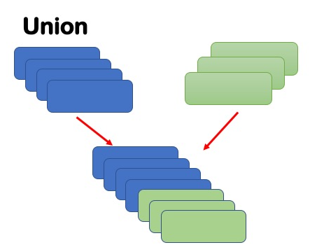

Slide 63
Lazy Evaluation
Transformations does not make the Spark cluster do anything. It is only when an action is called that the Spark cluster begins execution, hence the saying Spark is lazy.
Before executing an action, all the Spark makes a data processing plan. We call this plan the Directed Acyclic Graph (DAG).

Slide 64
Actions
Transformations allow us to build up our logical transformation plan. To trigger the computation, we run an action.
Actions instructs Spark to perform computation and send the result back to driver.

Slide 65
Examples of Transformations and Actions
Transformations | Actions
spark.read() | .count()
.where() | .collect()
.join | .take()
.write() | .show()

Slide 66
Steps for installing Spark in Local
Install Java version JDK
Install Python 3
Download and Extract Apache Spark
Setting Environment variables for Java, Python and PySpark
Installing winutils
Configuring the log level for Spark
Create conda environment

Slide 67
Installing Spark in Local Environment
winutils.exe file, which is an Hadoop component for Windows OS.

Slide 68
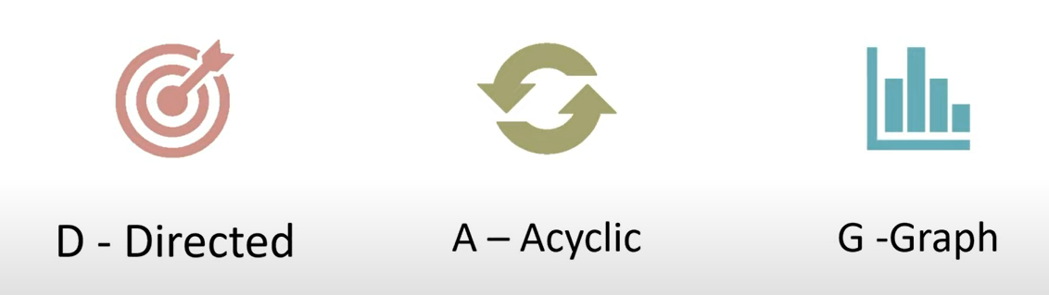
DAG
D- Directed
A- Acyclic
G- Graph

Slide 69

Spark DAG
It is logical flow of operations
A job is associated with a chain of RDD dependencies organized in a DAG.

Slide 70
Vertices represent the RDDs and the edges represent the operation to be applied on RDD
Operation 2.1
Operation 1
Operation 3
Operation 2.2

Slide 71
Why are DAG needed
Most optimised plan
Minimize shuffling
Fault Tolerance
RDD recovery

Slide 72
How DAGs work
RDD has 2 types of transformation
Narrow
Wide
When an action is encountered
Spark creates the DAG and submits it to the DAG scheduler
DAG scheduler splits the graph into multiple stages
Stages are created based on the transformations
Narrow transformations will be grouped (Pipe Lined together) into a single stage.
DAG scheduler will then submit the stages into the task scheduler.

Slide 73
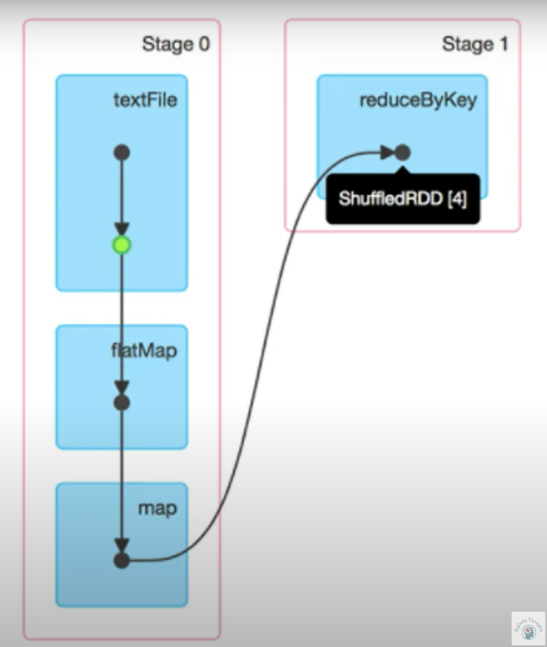
DAG Visualization
Blue Box- Spark Operation
Black Dots- RDDs created
Green Dot- Cached RDD in stage

Slide 74
Stage 4
Task 6
Job 2
Stage 3
Task 5
Task 4
Stage 2
Hello Spark
Task 3
Job 1
Stage 1
Task 2
Job 0
Stage 0
Task 1
Task 0

Slide 75
Spark Optimization
Cache
Persist

Slide 76
Spark Memory Management
Spark is a memory based data processing framework hence memory plays a central role.
Efficient memory usage is key to good performance therefore it is important to understand how spark does memory management.

Slide 77
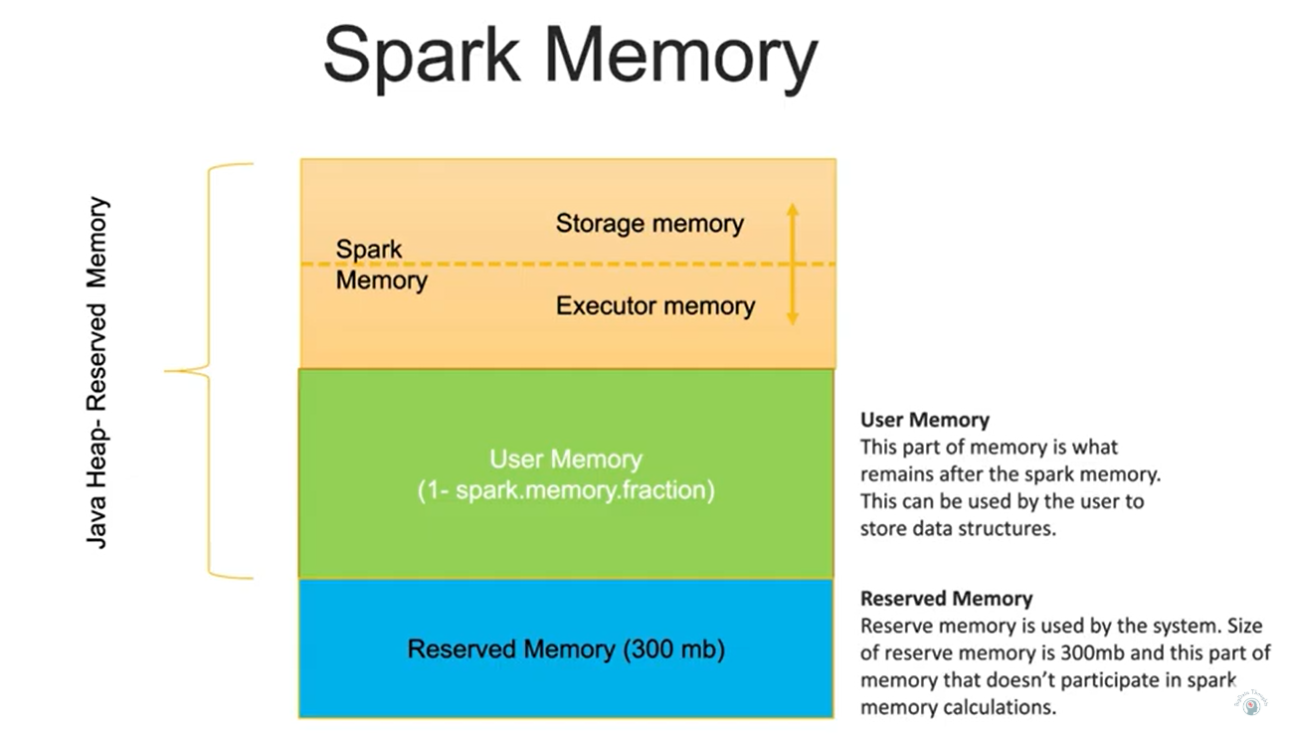

Slide 78
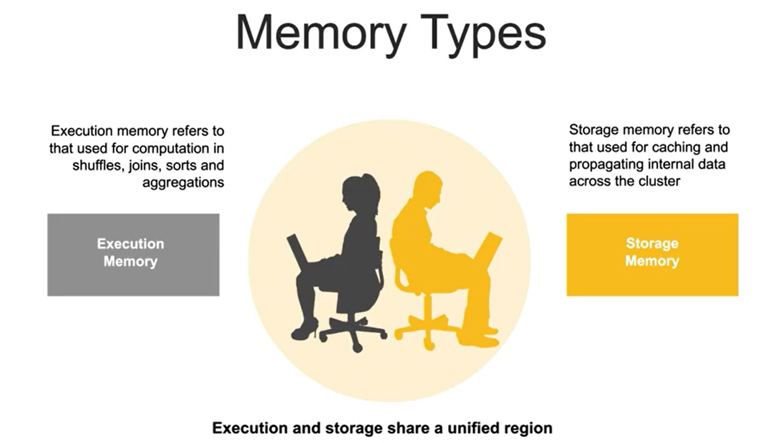

Slide 79
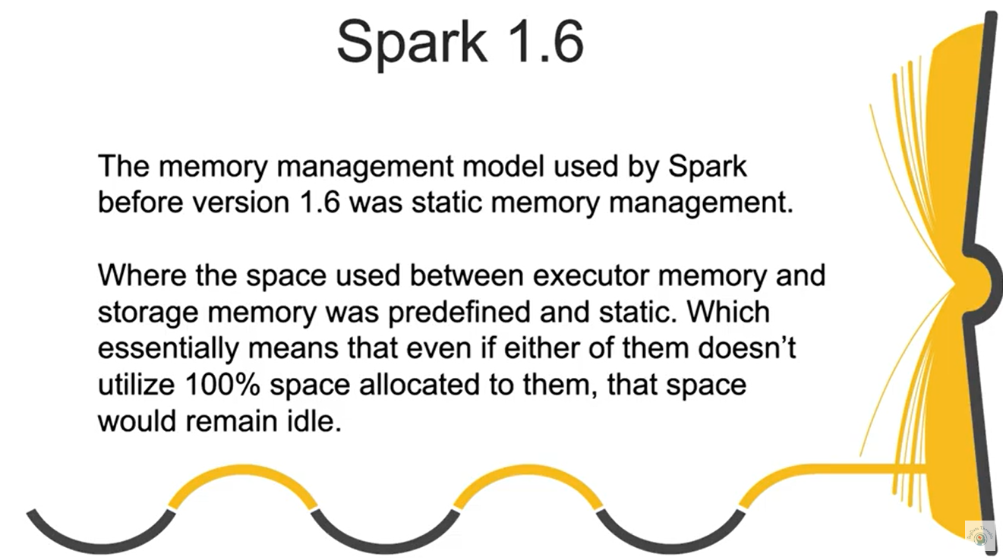

Slide 80
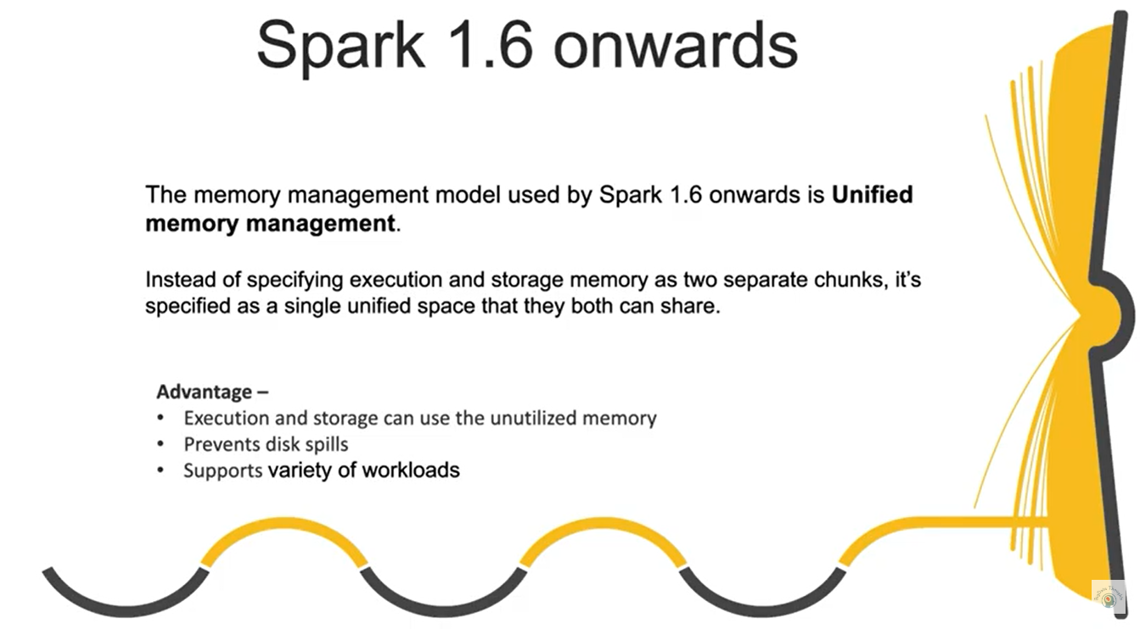

Slide 81
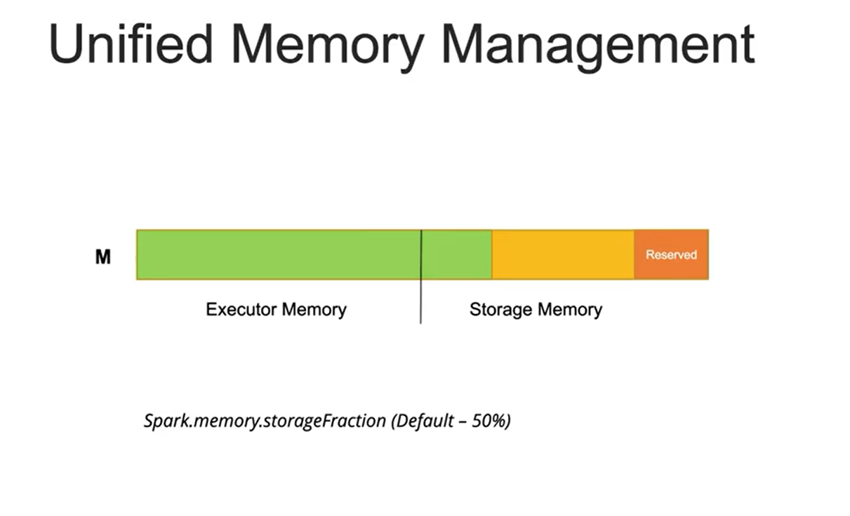

Slide 82
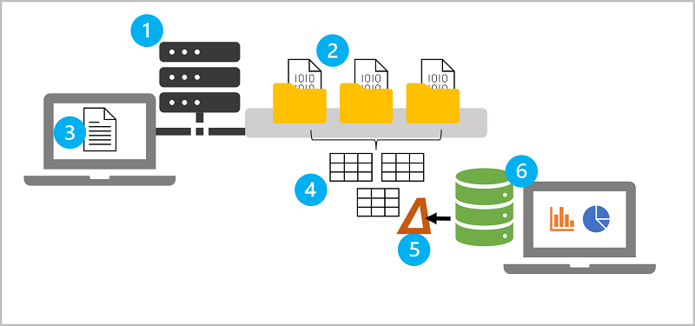
https://learn.microsoft.com/en-gb/training/modules/explore-azure-databricks/04-key-concepts

Slide 84

What is Databricks?
With origins in academia and the open source community, Databricks was founded in 2013 by the original creators of Apache Spark, Delta lake and ML flow.
Data + AI
Today, more than 10000 organizations worldwide rely on Databricks to enable massive scale data engineering collaborative data science, full lifecycle machine learning and business analytics.
10000 +

Slide 85
Discovering Databricks
The Original creators of Apache Spark established Databricks to solve the worlds toughest data problems.
Databricks was launched as a Spark based unified data analytics platform in the cloud.

Slide 86
Introduction to Databricks
Databricks was launched as a Spark-based unified data analytics platform in the cloud.
Databricks provides a collaborative platform for data engineering and data science.
It has also revolutionized the existing data lakes by introducing the Lakehouse architecture.

Slide 87
Any industry that uses data has something Databricks can offer
Data engineer
Data scientist
Data analyst
Business intelligence analyst

Slide 88
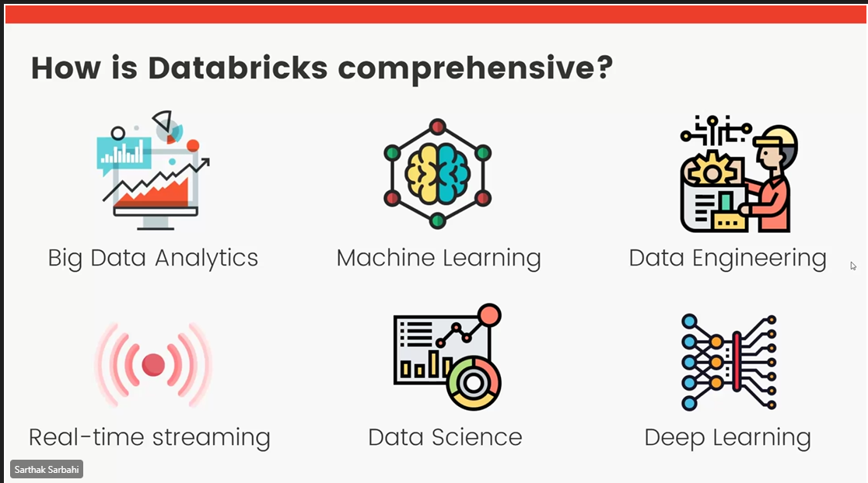

Slide 89
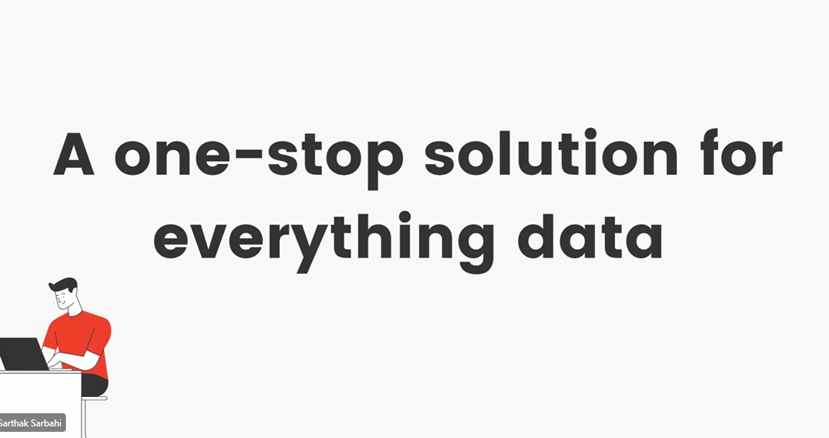

Slide 90
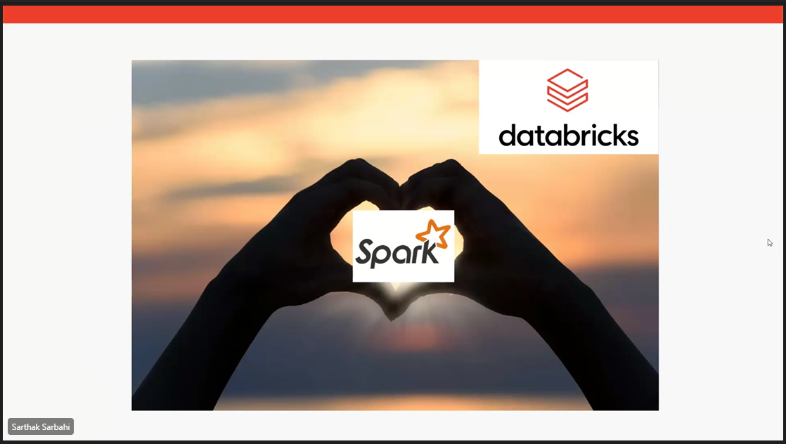

Slide 91
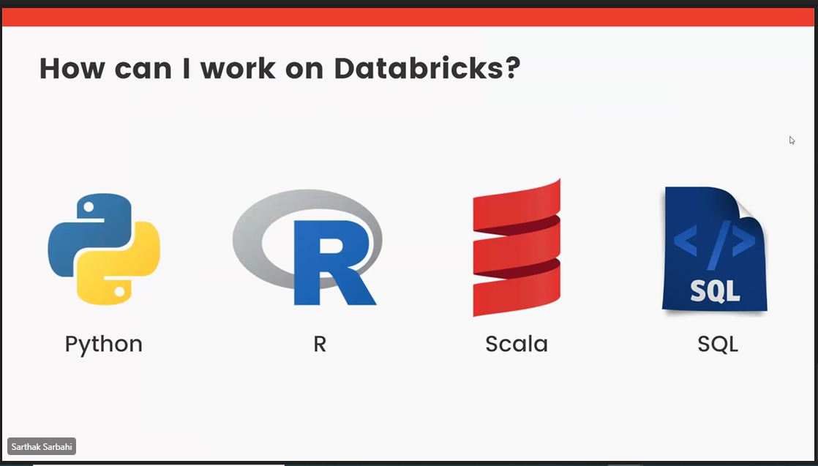

Slide 92
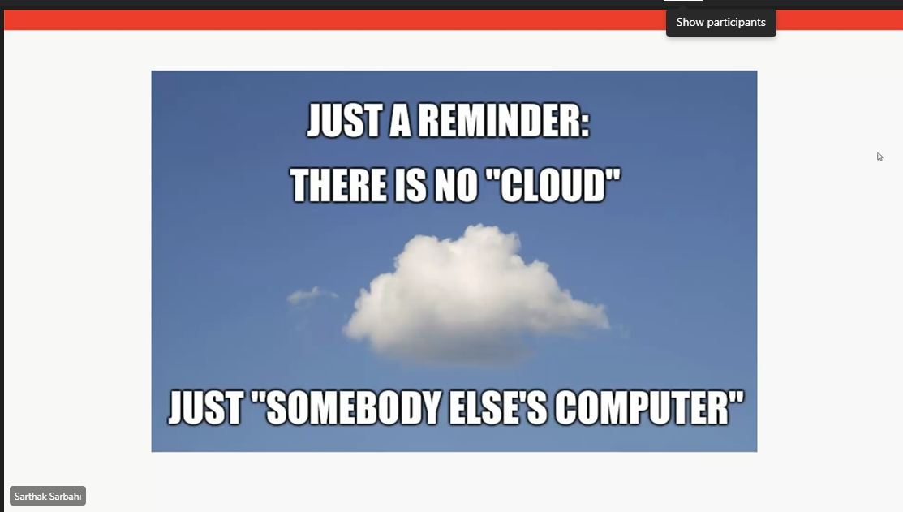

Slide 93
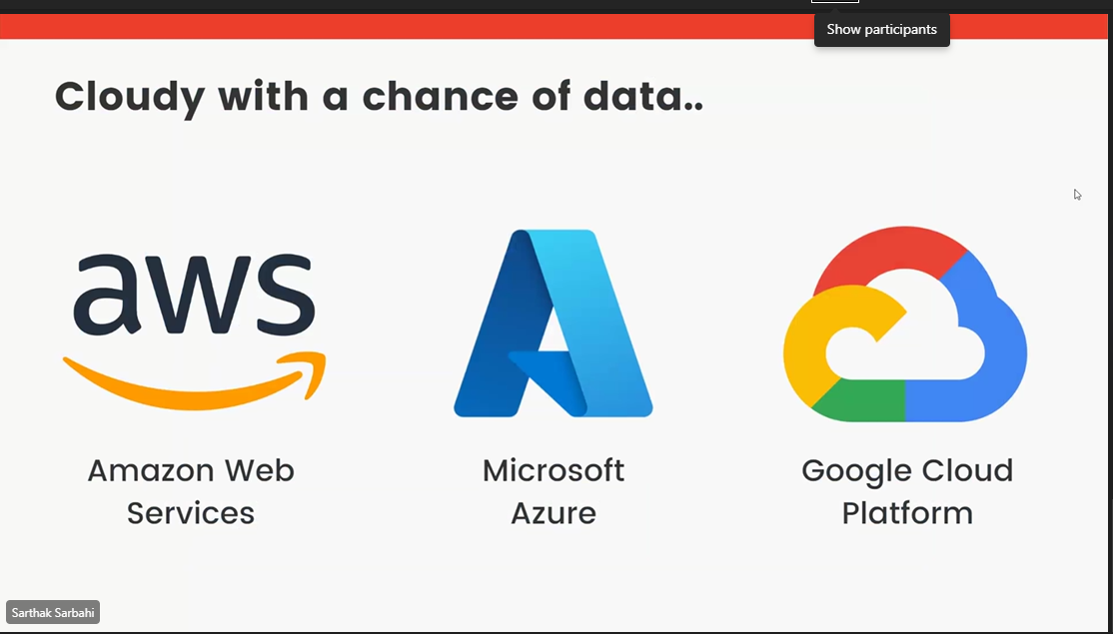

Slide 94
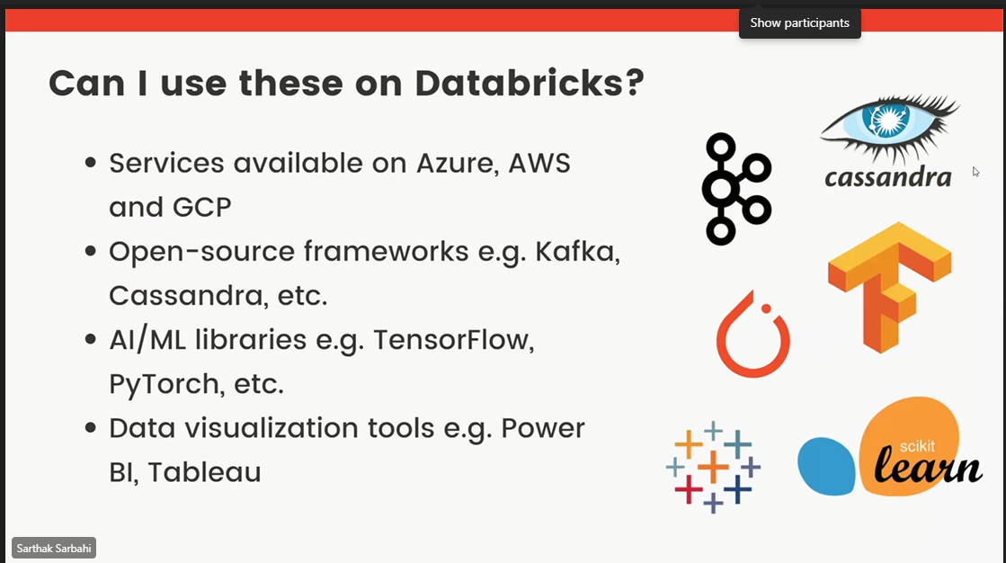

Slide 95
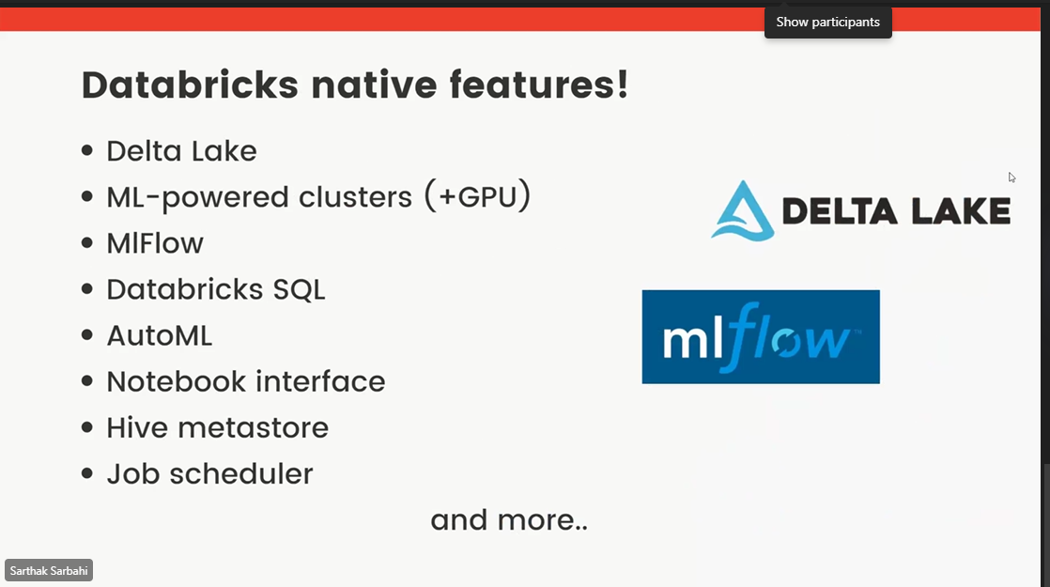

Slide 96
Row Based (CSV, TSV and Avro)
 | Id | Name | State | Age
Row 1 | 100 | Albert | German | 40
Row 2 | 101 | John | United Kingdom | 50
Row 3 | 102 | Peter | United States of America | 39
Row 4 | 103 | Raman | Indian | 55
Columnar (Parquet, Delta and ORC)
 | Row 1 | Row 2 | Row 3 | Row 4
Id | 100 | 101 | 102 | 103
Name | Albert | John | Peter | Raman
State | German | United Kingdom | United States of America | Indian
Age | 40 | 50 | 39 | 55
Naval Yemul

Slide 97

Naval Yemul

Slide 98
Delta Lake
Open-source storage framework that brings reliability to data lakes
Naval Yemul

Slide 99
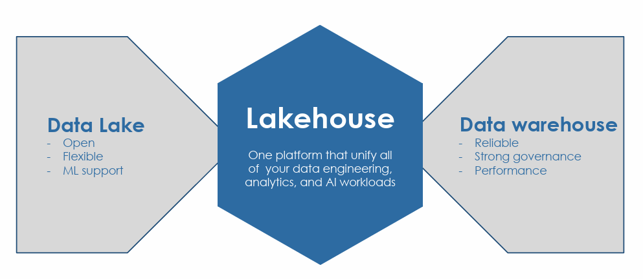
Lakehouse

Slide 100
Delta Lake
Data Warehouse | Data Lake | Delta Lake
Only structured Data | Structured/semi-structured/unstructured | Structured/semi-structured/unstructured/streaming
Schema-on-write | Schema-on-read | Schema-on-read
Support ACID transaction | Minimal support to ACID transaction | Supports ACID transaction
Does not corrupt the system | Leaves system in corrupted state | Does not corrupt the system

Slide 101

Delta Lake brings ACID to object storage
Atomicity means all transactions either succeed or fail completely
Consistency guarantees relate to how a given state of the data is observed by simultaneous operations
Isolation refers to how simultaneous operations conflict with one another. The isolation guarantees that Delta Lake provides do differ from other systems
Durability means that committed changes are permanent

Slide 102
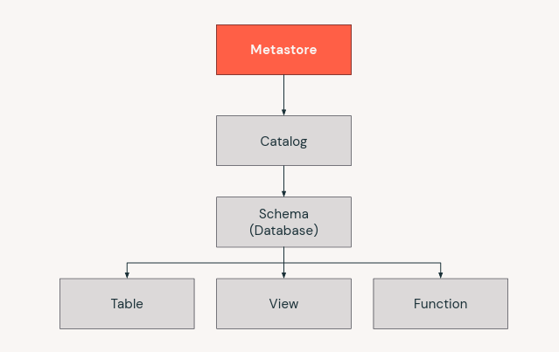
Data objects in the Lakehouse
Naval Yemul

Slide 103
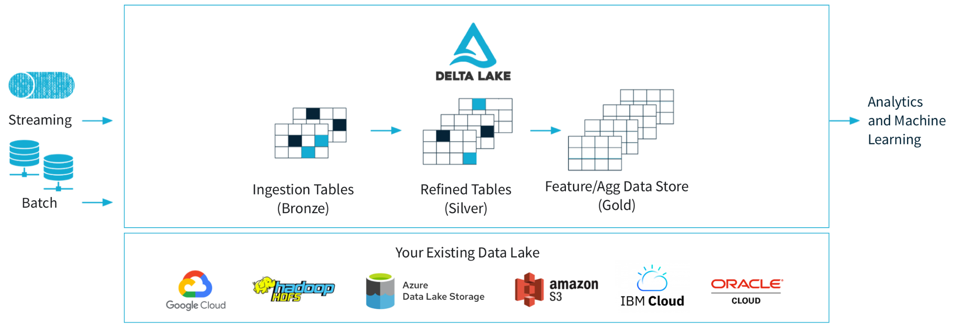
Mutlihop Architecture
Naval Yemul

Slide 104
Delta Lake is/is not
Is
Open-source technology
Storage framework/layer
Enabling building Lakehouse
Is Not
Proprietary technology
Storage format/medium
Data warehouse/Database
service
Naval Yemul

Slide 105
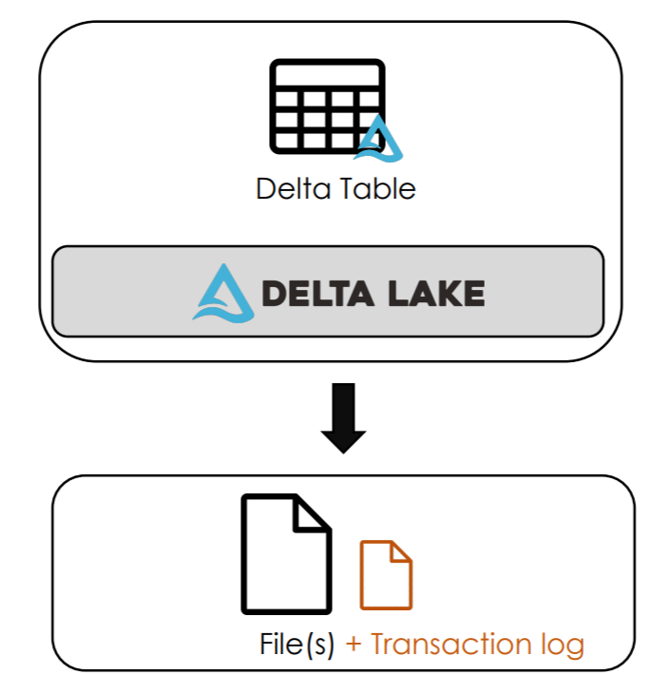
Storage
Cluster
Naval Yemul

Slide 106
Transaction log (Delta log)
Ordered records of every transaction performed on the table
Single Source of Truth
JSON file contains commit information:
Operation performed + Predicates used
data files affected (added/removed)
Naval Yemul

Slide 107
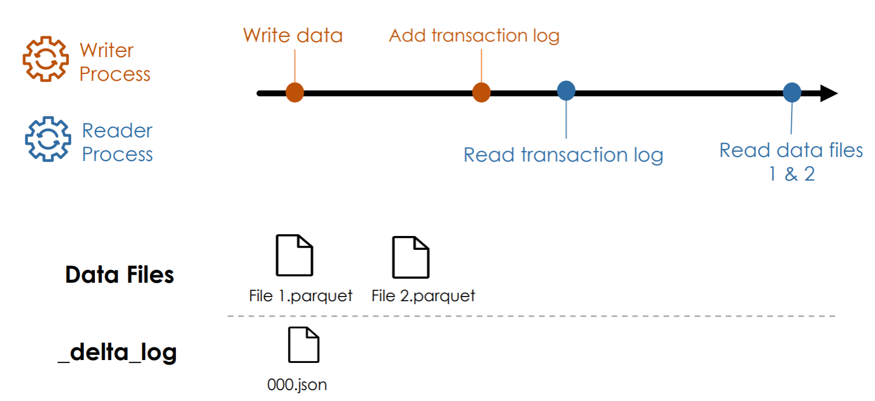
Writes/Reads
Naval Yemul

Slide 108
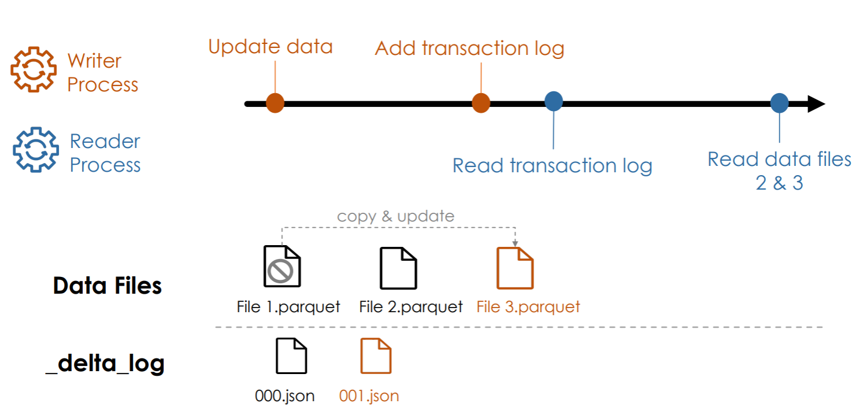
Updates
Naval Yemul

Slide 109
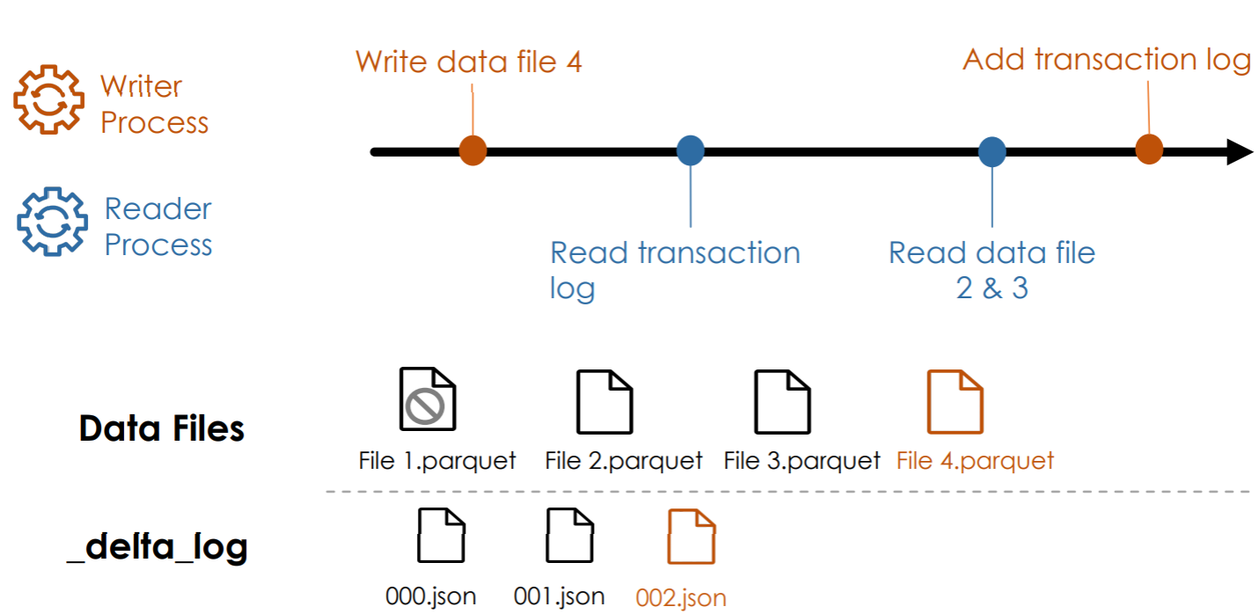
Simultaneous Writes/Reads
Naval Yemul

Slide 110
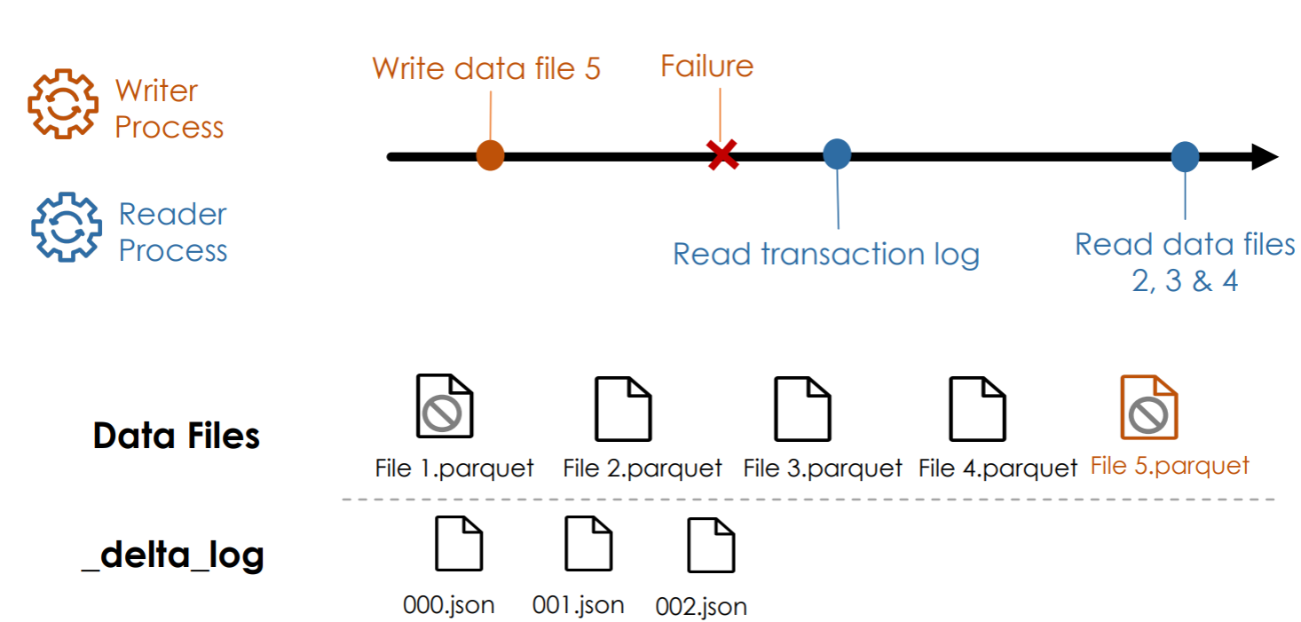
Failed Writes
Naval Yemul

Slide 111
Delta Lake Advantages
Brings ACID transactions to object storage
Handle scalable metadata
Full audit trail of all changes
Builds upon standard data formats: Parquet + Json
Naval Yemul

Slide 112
Mount ADLS container to Databricks
Create Service Principal
Create Azure Data Lake Storage Gen 2
Creating Azure Key Vault
Creating Databricks secret scope
Naval Yemul

Slide 113
AutoLoader
Auto Loader incrementally and efficiently processes new data files as they arrive in cloud storage without any additional setup.
Naval Yemul

Slide 114

Structured Streaming
Naval Yemul

Slide 115
Structured Streaming
Data Stream​
Any data source that grows over time​
New files landing in cloud storage​
Updates to a database captured in a CDC feed​
Events queued in a pub/sub messaging feed​
Naval Yemul

Slide 116
Learning Objectives
Process streaming data
DataStreamReader
DataStreamWriter
Naval Yemul

Slide 117
Processing Data Stream
Reprocess the entire source dataset each time
Only process those new data added since last update Structured Streaming
Naval Yemul

Slide 118
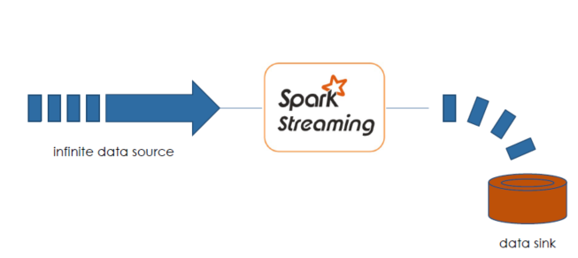
Spark Structured Streaming
Naval Yemul

Slide 119
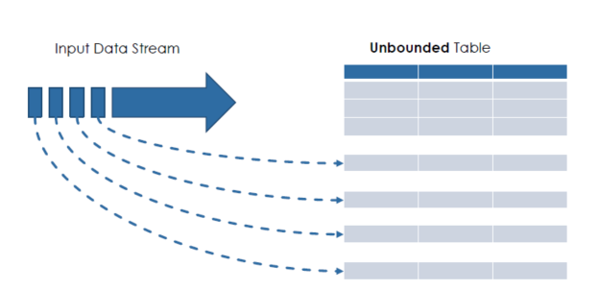
Treating Infinite Data as a Table
Naval Yemul

Slide 120
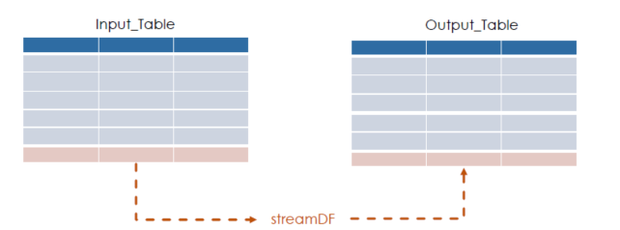
Input Streaming Table
streamDF.writeStream
.trigger(processingTime="2 minutes")
.outputMode("append")
.option("checkpointLocation", "/path")
.table("Output_Table")
streamDF = spark.readStream .table("Input_Table")
Naval Yemul

Slide 121

Trigger Intervals
streamDF.writeStream
.trigger(processingTime="2 minutes")
.outputMode("append")
.option("checkpointLocation", "/path")
.table(”Output_Table")
Naval Yemul

Slide 122

Output Modes
streamDF.writeStream
.trigger(processingTime="2 minutes")
.outputMode("append")
.option("checkpointLocation", "/path")
.table(”Output_Table")
Naval Yemul

Slide 123
Checkpointing
Store stream state
Track the progress of your stream processing
Can Not be shared between separate streams
streamDF.writeStream
.trigger(processingTime="2 minutes")
.outputMode("append")
.option("checkpointLocation", "/path")
.table(”Output_Table")
Naval Yemul

Slide 124
Guarantees
1.Fault Tolerance
Checkpointing + Write-ahead logs
record the offset range of data being processed during each trigger interval.
2. Exactly-once guarantee
Idempotent sinks
Naval Yemul

Slide 125
Unsupported Operations
Some operations are not supported by streaming DataFrame
Sorting
Deduplication
Advanced methods
Windowing
Watemarking
Naval Yemul

Slide 126
Incremental Data
Ingestion from Files
Naval Yemul

Slide 127
Learning Objectives
What is incremental data Ingestion from file
COPY INTO
Auto Loader
Naval Yemul

Slide 128
Incremental Data Ingestion
Loading new data files encountered since the last ingestion
Reduces redundant processing
2 mechanisms:
COPY INTO
Auto loader
Naval Yemul

Slide 129
Databricks Autoloader
Structured Streaming
Can process billions of files
Support near real-time ingestion of millions of files per hour.
Naval Yemul

Slide 130
What is Autoloader?
Autoloader combines our three approaches of:
Storing Metadata about what has been read
Using Structured Streaming for immediate processing
Utilising Cloud Native components to optimise identifying arriving files
Naval Yemul

Slide 131
Auto loader Checkpointing
Store metadata of the discovered files
Exactly-once guarantees
Fault tolerance
Naval Yemul

Slide 132
Auto Loader in PySpark API
spark.readStream
.format("cloudFiles")
.option("cloudFiles.format", <source_format>)
.load('/path/to/files’)
.writeStream
.option("checkpointLocation", <checkpoint_directory>)
.table(<table_name>)
Naval Yemul

Slide 133
Auto Loader + Schema
spark.readStream
.format("cloudFiles")
.option("cloudFiles.format", <source_format>)
.option(“cloudFiles.schemaEvolution”,”path)
.load('/path/to/files’)
.writeStream
.option("checkpointLocation", <checkpoint_directory>)
.option("mergeSchema", “true”)
.table(<table_name>)
Naval Yemul

Slide 134
COPY INTO vs. Auto Loader
COPY INTO
Thousands of files
Less efficient at scale
Auto Loader
Millions of files
Efficient at scale
Naval Yemul

Slide 135
How do we handle Evolution?
Fail the stream
Manually Intervene
Automatically Evolve
Naval Yemul

Slide 136
Schema Inference
Cloudfiles
.schemaLocation - where to share the schema
.inferColumnTypes - sample data to infer types
.schemaHints - manually specify data types for certain columns
Naval Yemul

Slide 137
Schema Evolution
To allow for schema evolution, we can include a schema evolution mode option:
CloudFiles.schemaEvolutionMode
addNewColumns – Fail the job, updates the schema metastore
failOnNewColumns – Faile the job, no updates made
rescue – Do not fail, pull all unexpected data into_rescued_data
none – Ignore any new columns
Naval Yemul

Slide 138
COPY INTO
SQL command
Idempotently and incrementally load new data files
Files that have already been loaded are skipped.
Naval Yemul

Slide 139
COPY INTO
COPY INTO my_table
FROM '/path/to/files’
FILEFORMAT = <format>
FORMAT_OPTIONS (<format options>)
COPY_OPTIONS (<copy options>);
Naval Yemul

Slide 140
Example
COPY INTO my_table
FROM '/path/to/files’
FILEFORMAT = CSV
FORMAT_OPTIONS ('delimiter' = '|’,
'header' = 'true')
COPY_OPTIONS ('mergeSchema' = 'true’)
Naval Yemul

Slide 141
DELTA LIVE TABLE

Slide 142


Slide 143


Slide 144


Slide 145


Slide 146


Slide 148


Slide 149


Slide 150


Slide 151


Slide 152


Slide 153


Slide 154


Slide 155


Slide 156


Slide 157

Unity Catalog
Unity Catalog is a Databricks offered unified solution for implementing data governance in the Data Lakehouse

Slide 158
Data Governance
Is the process of managing the availability, usability, integrity and security of the data present in an enterprise
Controls access to the data for the users
Ensures that the data is trust worthy and not misused
Helps implement privacy regulations such as GDPR, CCPA et

Slide 159


Slide 160

Without Unity Catalog

Slide 161

With Unity Catalog

Slide 162

Unity Catalog

Slide 163


Slide 164


Slide 165

Security model

Slide 166


Slide 167


Slide 168

Dynamic Views

